Slide 1
Advanced Cancer Classification and Sentiment Analysis:
Integrating RESNET, ViT, and LSTM Models in a Flask Web Application
Baodong Zhang, 04.06.2024

Slide 2
Introduction
Project Overview:
The objective of this project is to classify cancer in gastric pathology slides using two different models: RESNET and Vision Transformer (ViT). Additionally, a simple website will be constructed using Flask, where these models will be deployed. Users can upload images to receive predictions and leave comments. An long short term memory(LSTM) model will be employed to perform sentiment analysis on user comments and provide appropriate responses.

Slide 3

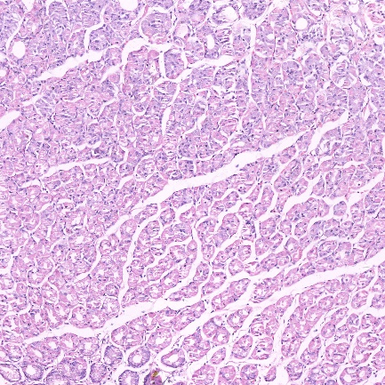
Data Collection and Preprocessing
Data preparation
https://www.payititi.com/opendatasets/show-35122.html
560 pcs images of pathological section of gastric cancer
140 pcs images of non cancer
Data Augmentation
Cancer: 560 pcs -----> 5628 pcs
non: 140 pcs -----> 5654 pcs
Train Test Split
Change image size 2048 x 2048 x 3 -----> 224 x 224 x3
Source: https://commons.wikimedia.org/wiki/File:Typical_cnn.png

Slide 4
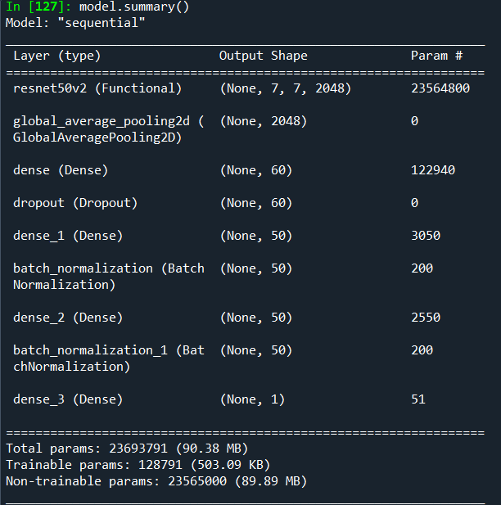
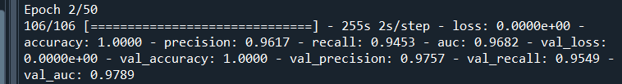
RESNET Model
Base model : ResNet50V2
GAP
Three hidden layer
drop out or BatchNormalization
Output layer:1 neuron sigmoid activation
Loss = 'binary_crossentropy',
Optimizer = 'adam'
Problem in training: loss is close to 0, accuracy equals 1 at the beginning of training.
Data Leakage
Source: C:/Users/zhang/rnn_tsf/gastric_cancer_cnn_lastversion_from_trainingcamp.py

Slide 5
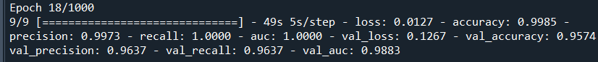
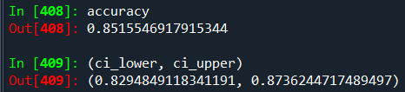
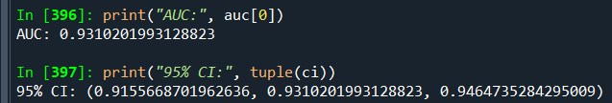
CNN Transfer Learning Model ResNet50V2
Solution:
First Train Test Split then Data Augumentation
Train cancer: 469 pcs ------> 5628 938 pcs non: 99 pcs ----- > 5654 704pcs
Validation cancer : 91pcs ------> 455 pcs non: 41 pcs ----- > 410 pcs
Slow convergence of the function ------> Divide all pixels by 255
Train with early stop patience=5, batch_size=164, epochs=1000
“pROC“ package
Recall(Sensitivity) > Precision (PPV) FP > FN model intends to classify negative as positive
Reason: unbalanced data, image size reduction
Source: C:/Users/zhang/rnn_tsf/gastric_cancer_cnn_lastversion_from_trainingcamp.py

Slide 6
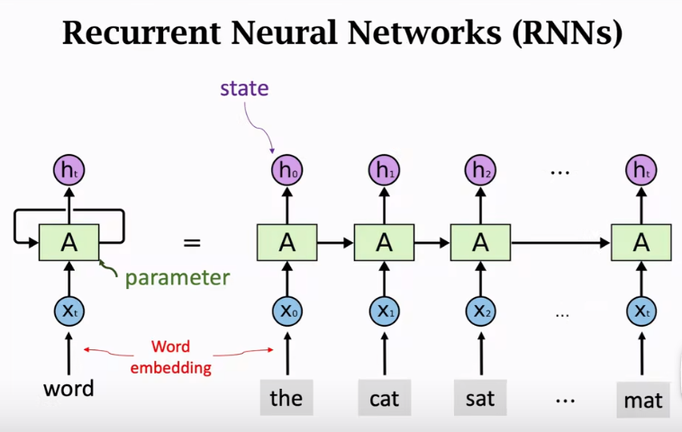
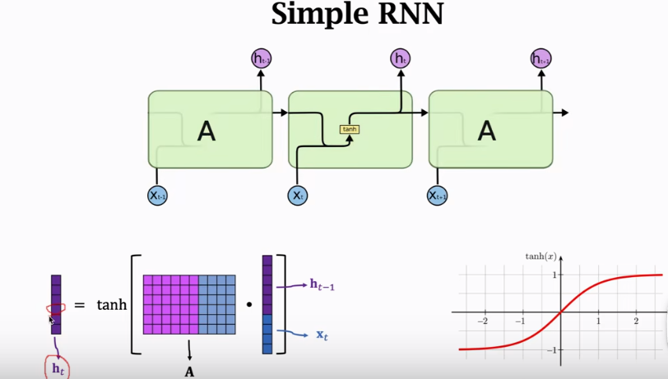
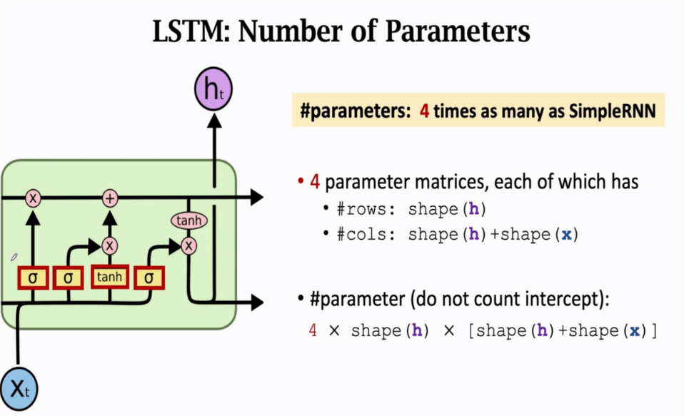
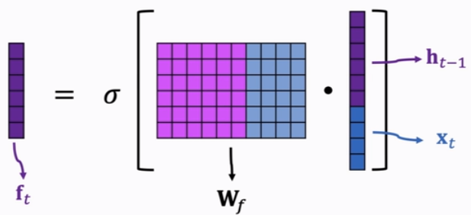
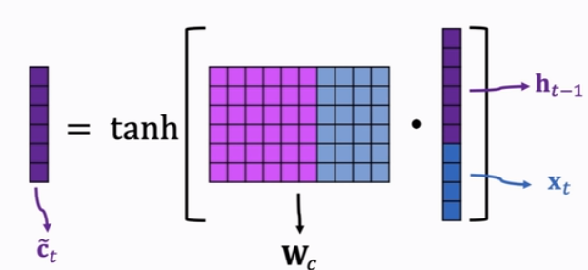
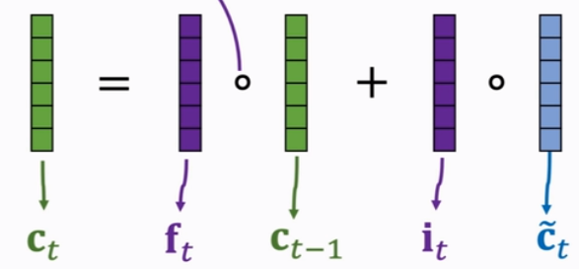
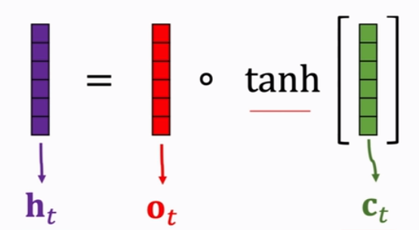
RNN & LSTM
it, ot are samilar to ft
Figures are from Christopher Olah‘s blog: Understanding LSTM Networks

Slide 7
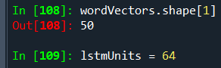
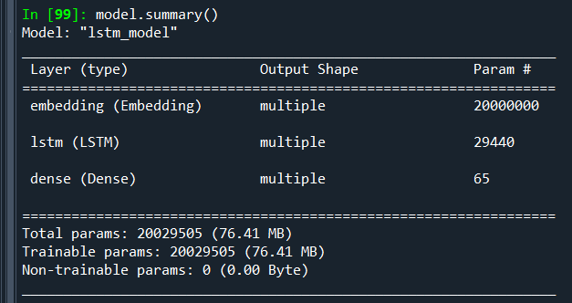
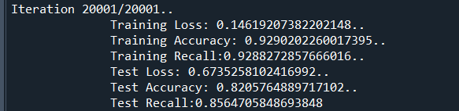
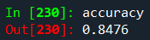
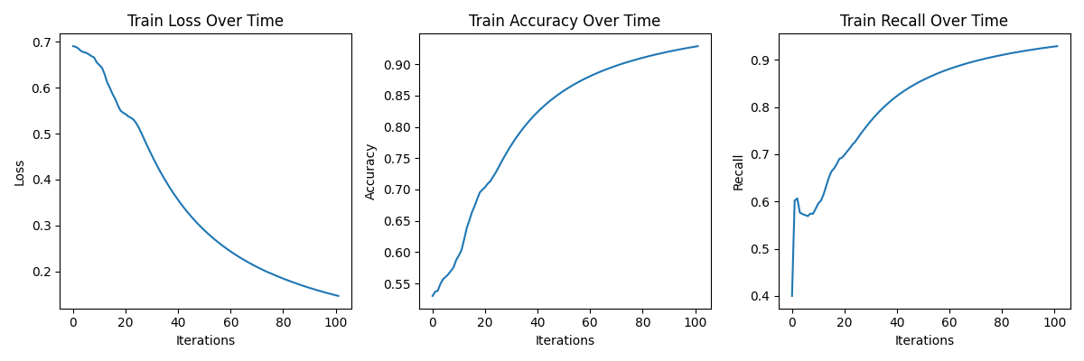
LSTM Trained with NLTK Review Data
Data: https://www.kaggle.com/datasets/pranayprasad/aclimdb
20000 Train 5000 Validation 50% positive
LSTM Param= (64*(64+50)+64)*4 =29440
Loss: BinaryCrossentropy optimizers:Adam
2nd Validation accuracy is better because predict-ion is converted to 0 or 1.
Source: C:/Users/zhang/rnn_tsf/rnn_nltk_simplifiedVersion_last.py
Evaluated every 200 iterations

Slide 8
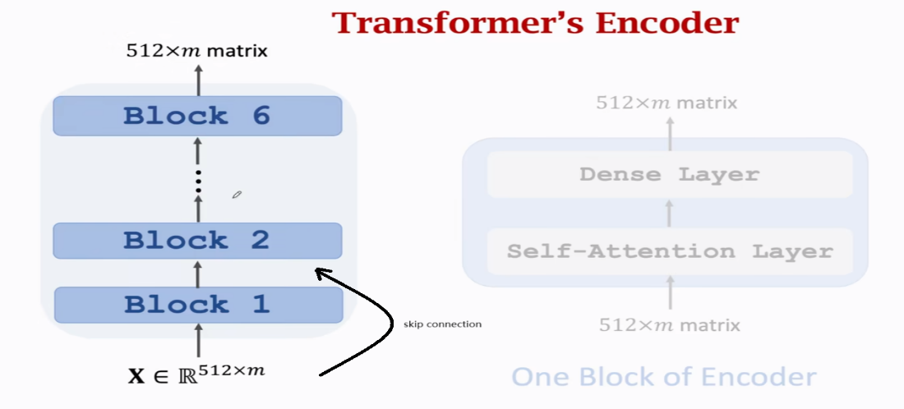
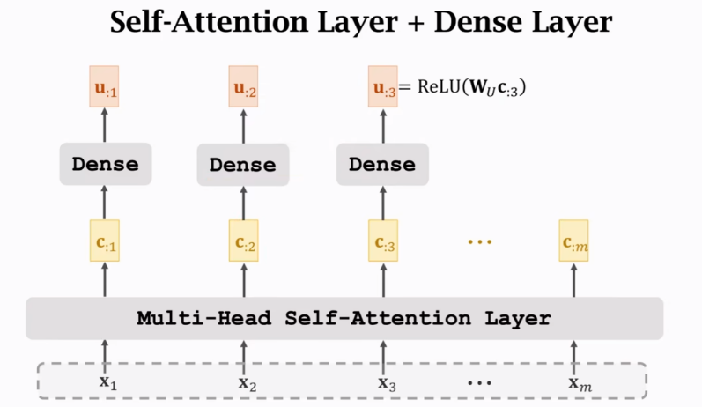
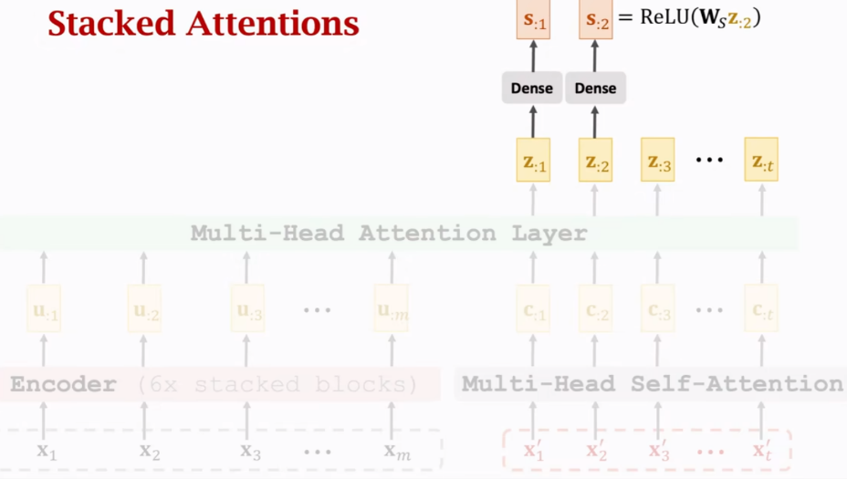
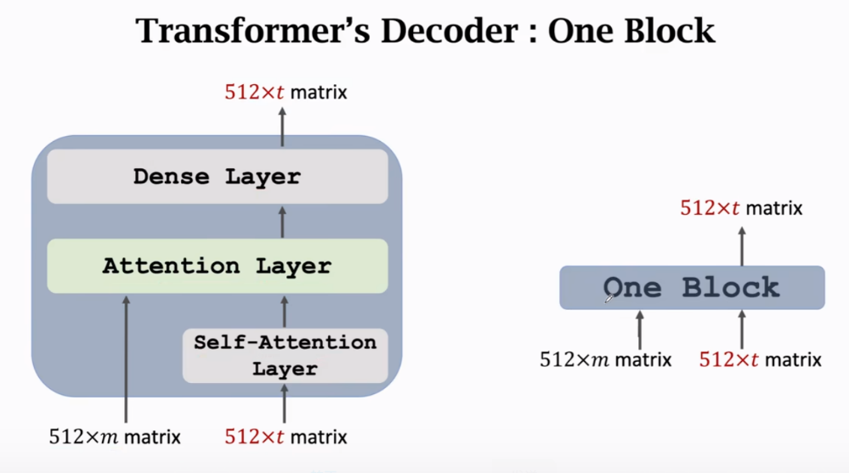
Build a Transformer
The output of a multi-head-attention is the concatenation of the output of multiple single-attention outputs.
Source [1] https://space.bilibili.com/1369507485/channel/collectiondetail?sid=788485
[2] Vaswani et al. Attention Is All You Need. INIPS 2017

Slide 9
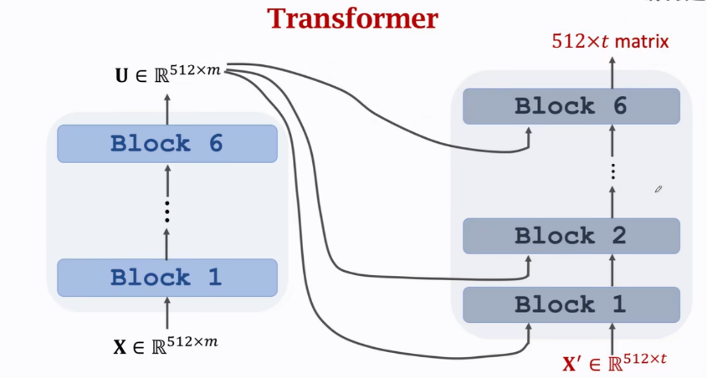
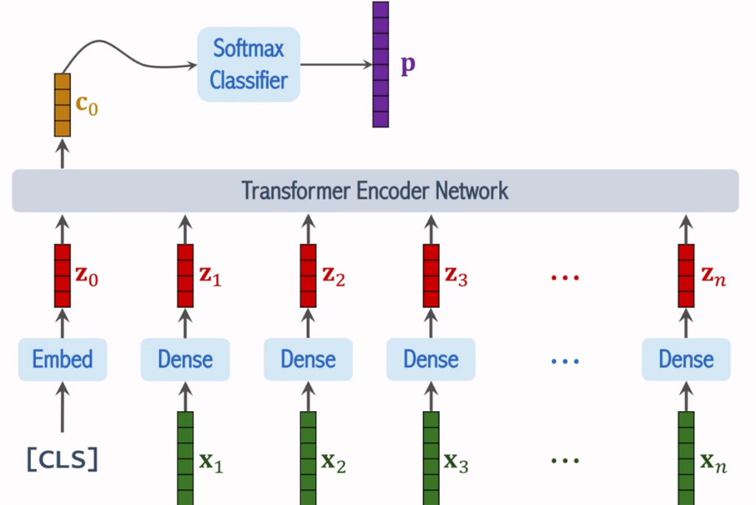
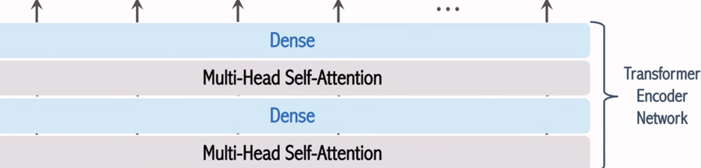
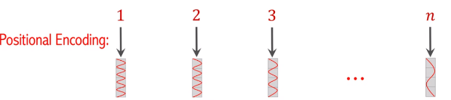
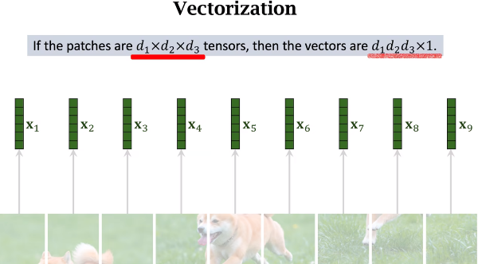
Transformer & VIT (Vision Transformer)
VIT applies the Transformer arch. to computer Version
Segment an image into small "patches
Embedding and augmented with positional information
Processed through Transformer encoder layers [1]
VIT
Source of picture https://space.bilibili.com/1369507485/channel/collectiondetail?sid=788485
[1]Dosovitskiy et al. An image is worth 16×16 words: transformers for image recognition atscale. In ICLR, 2021.

Slide 10
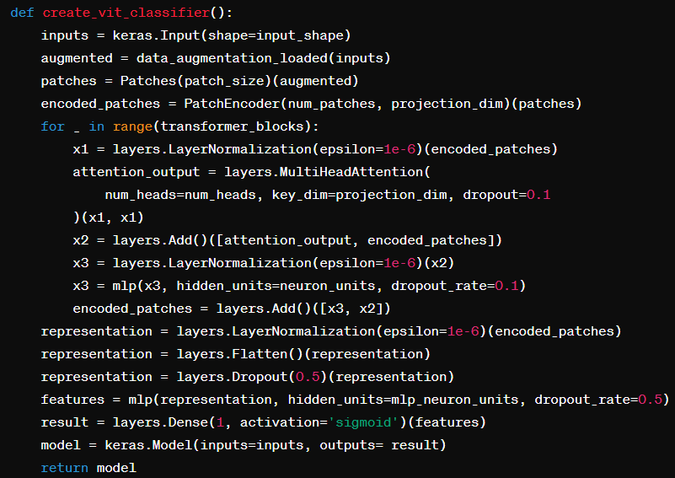
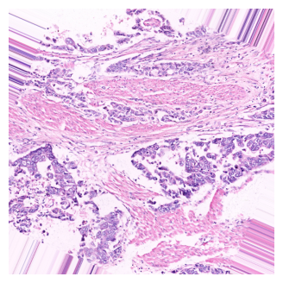
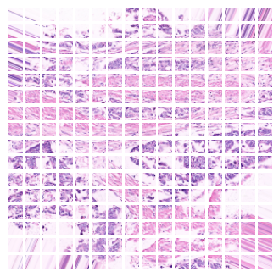
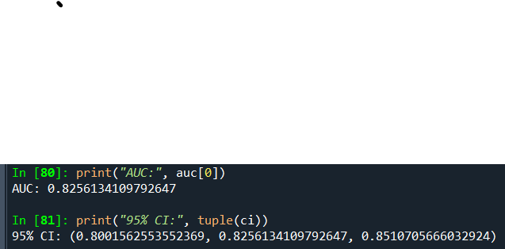
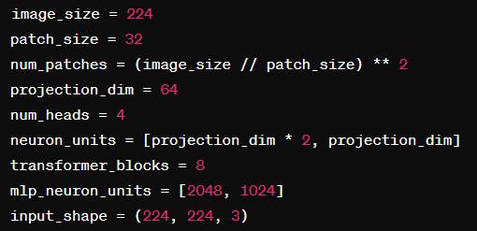
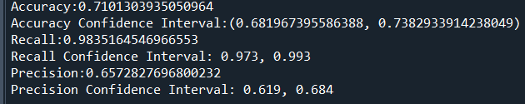
Build a ViT
Source: C:/Users/zhang/rnn_tsf/vit_gastric_model.py

Slide 11
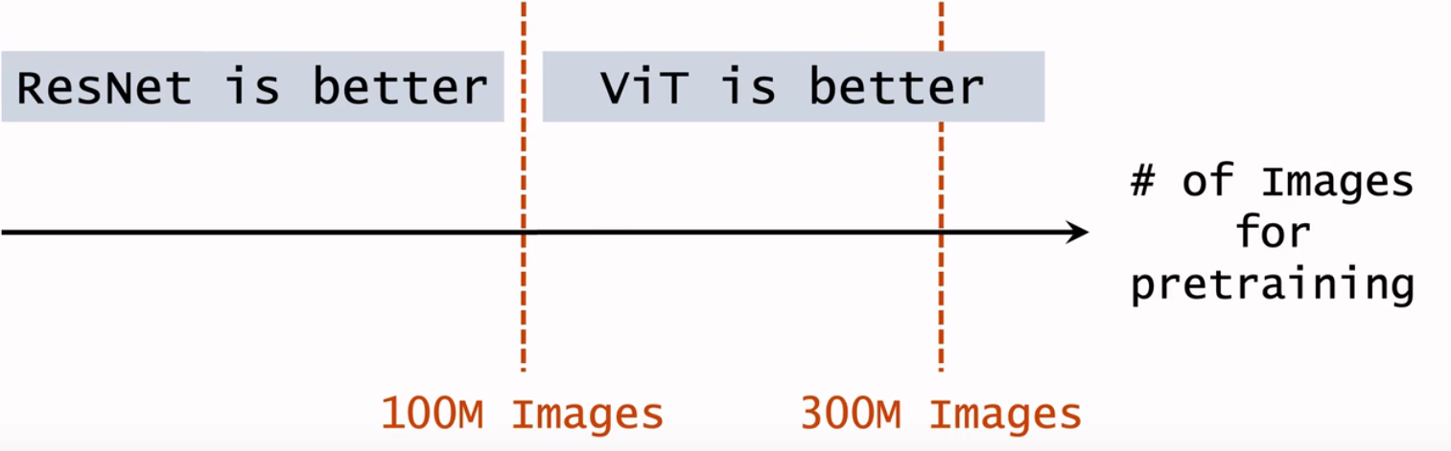
Resnet vs ViT
Train cancer: 469 pcs ------> 938 pcs non: 99 pcs ----- > 704 pcs
Validation cancer : 91pcs ------> 455 pcs non: 41 pcs ----- > 410 pcs
image size 2048 x 2048 x 3 ---------> 224 x 224 x3
 | Resnet | Vit
AUC: | 0.93 | 0.82
95% CI: | (0.92, 0.95) | (0.80, 0.85)
Accuracy: | 0.85 | 0.71
95% CI: | (0.83, 0.87) | (0.68, 0.74)
Recall: | 0.96 | 0.98
95% CI: | (0.94, 0.97) | (0.973, 0.99)
Precision: | 0.81 | 0.65
95% CI: | (0.78, 0.84) | (0.62, 0.68)
ViT beats CNNs (by a small margin), if the dataset for pretraining is sufficiently large (at least 100 million images) [1]
[1]Dosovitskiy et al. An Image is Worth 16x16 Words: Transformers for Image Recognition at Scale. In ICLR, 2021.

Slide 12
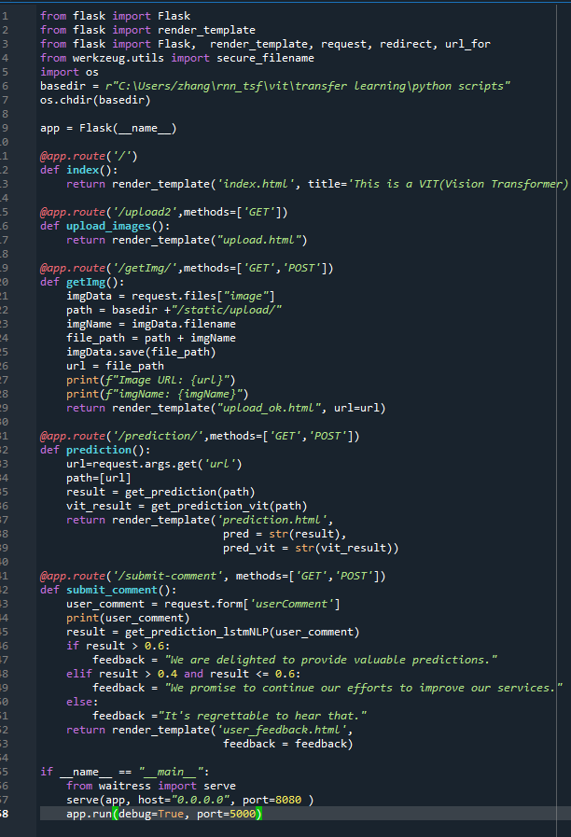
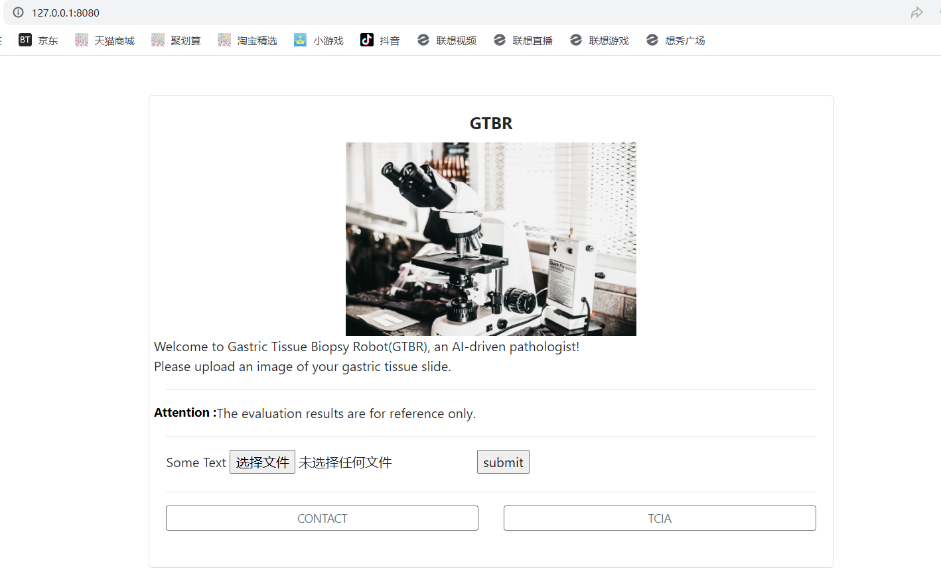
Web APP with Flask
Inspired by SkinCheck project of Leona
https://github.com/leona-ha/Skin-Screening_Web-App

Slide 13
Reference
CNN (Convolutional Neural Networks):
LeCun, Y., Bottou, L., Bengio, Y., & Haffner, P. (1998). Gradient-Based Learning Applied to Document Recognition. Proceedings of the IEEE, 86(11), 2278-2324.
LSTM (Long Short-Term Memory):
Hochreiter, S., & Schmidhuber, J. (1997). Long Short-Term Memory. Neural Computation, 9(8), 1735-1780.
RESNET (Residual Networks):
He, K., Zhang, X., Ren, S., & Sun, J. (2016). Deep Residual Learning for Image Recognition. Proceedings of the IEEE Conference on Computer Vision and Pattern Recognition (CVPR), 770-778. Link
Transformer Model:
Vaswani, A., Shazeer, N., Parmar, N., Uszkoreit, J., Jones, L., Gomez, A. N., ... & Polosukhin, I. (2017). Attention is All You Need. Advances in Neural Information Processing Systems (NeurIPS). Link
ViT (Vision Transformer):
Dosovitskiy, A., Beyer, L., Kolesnikov, A., Weissenborn, D., Zhai, X., Unterthiner, T., ... & Houlsby, N. (2021). An Image is Worth 16x16 Words: Transformers for Image Recognition at Scale. International Conference on Learning Representations (ICLR). Link

